Slide 1
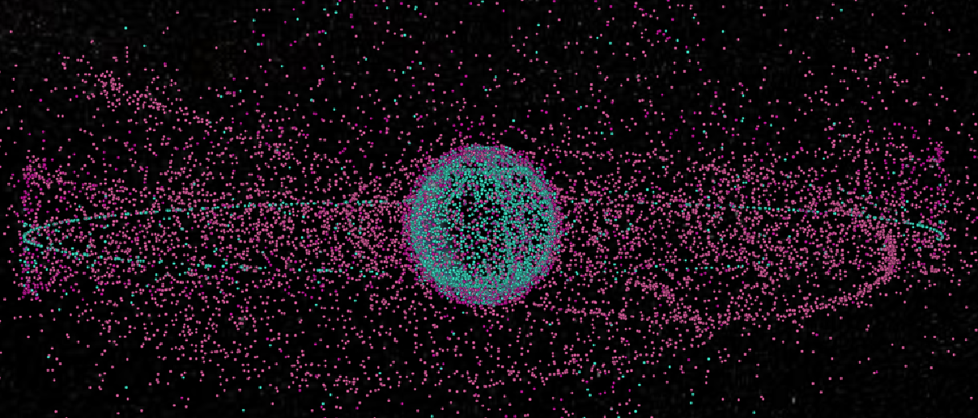
Space Debris
Jiaxin Liu
Torben Blei
Philipp Schollmeier
Ziqing Yu
03. February 2023, Stuttgart

Slide 2
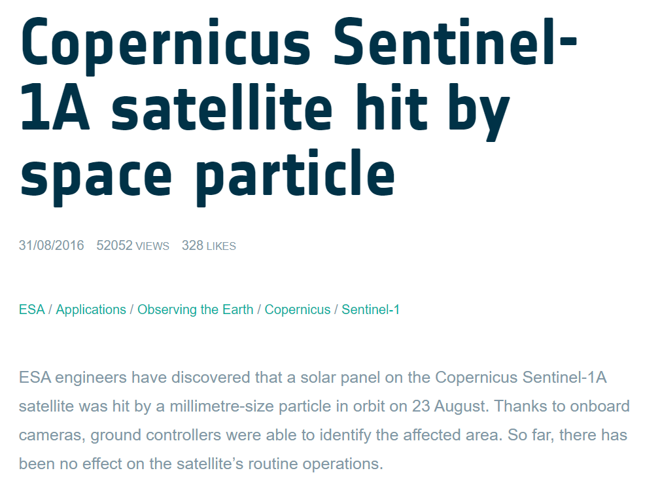
Why we are interested

Slide 3
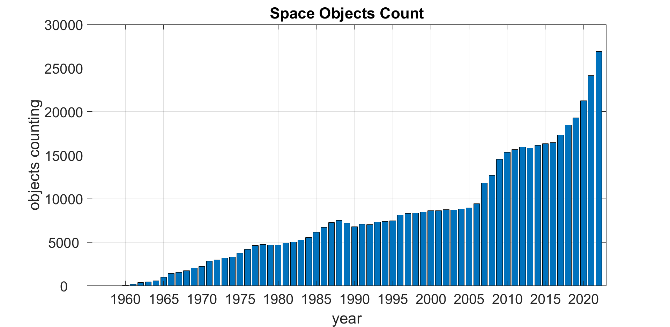
Objects counting

Slide 4
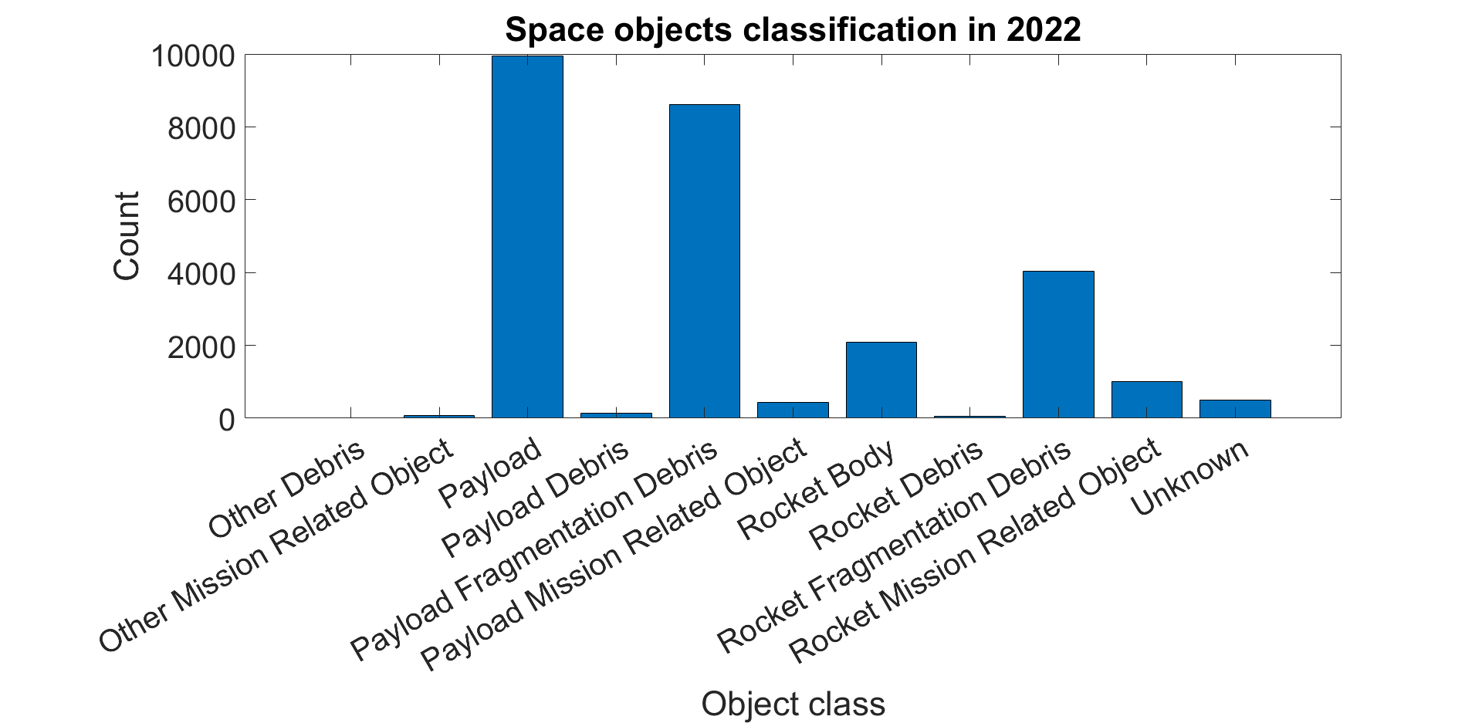
Objects classification in 2022

Slide 5
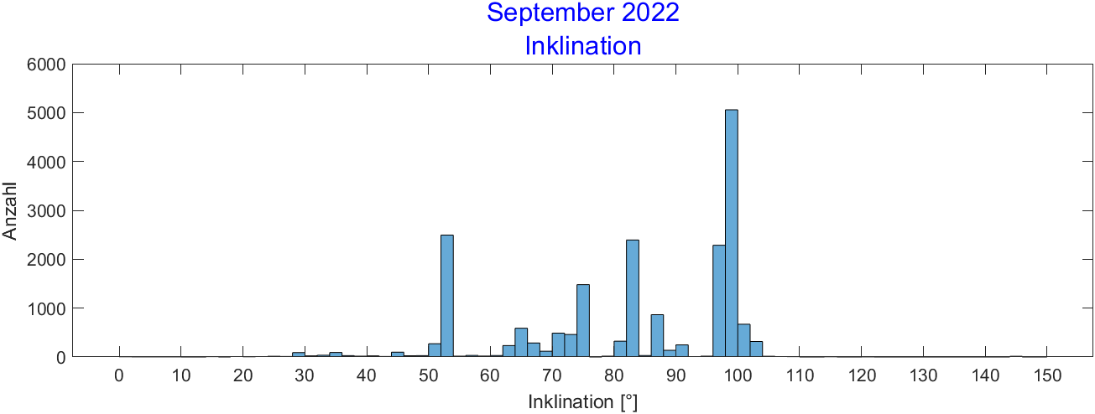
Inclination from 2005 - 2022

Slide 6
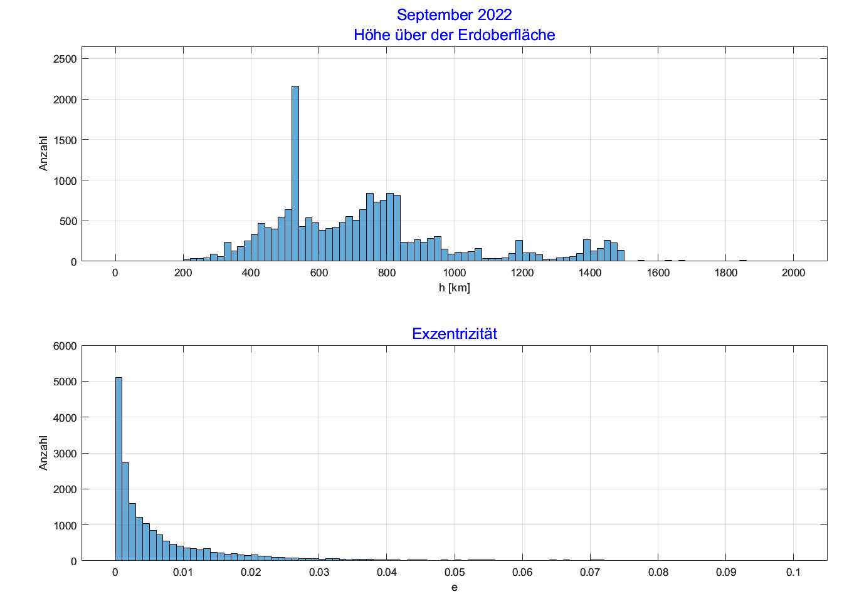
Height from 2005 - 2022

Slide 7
Gabbard Diagramm

Slide 8
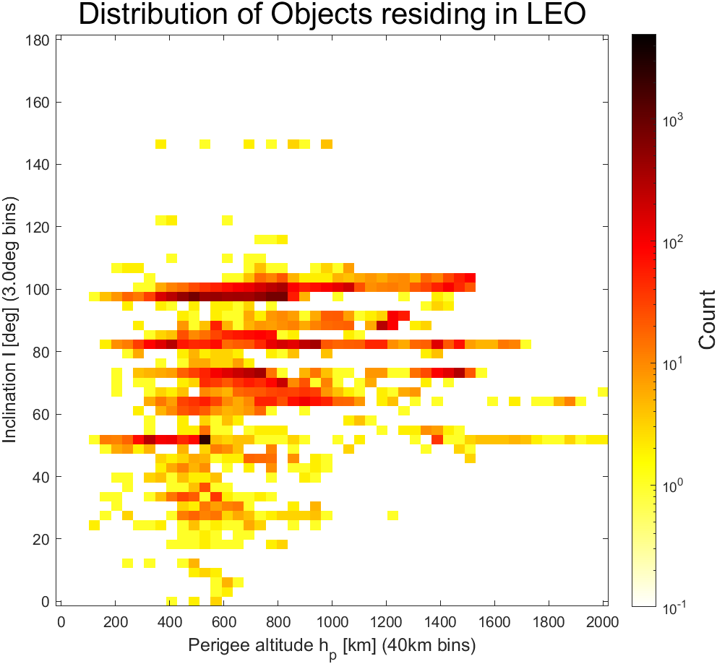
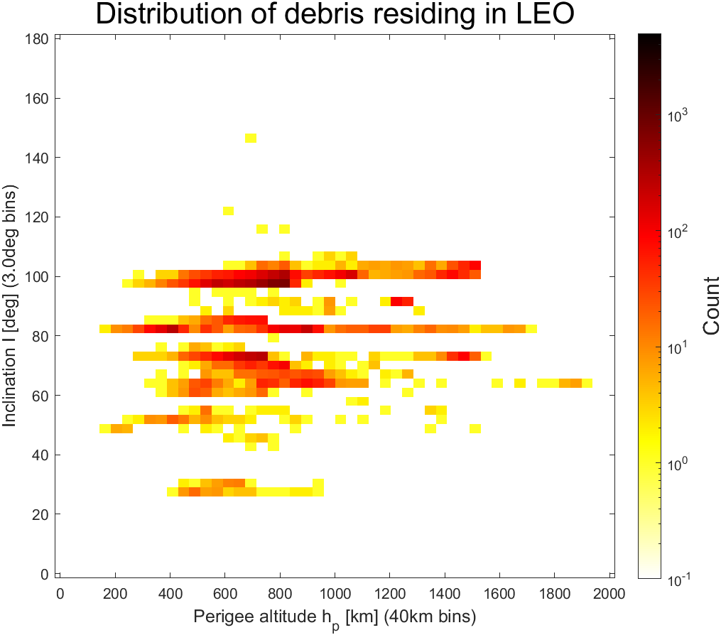
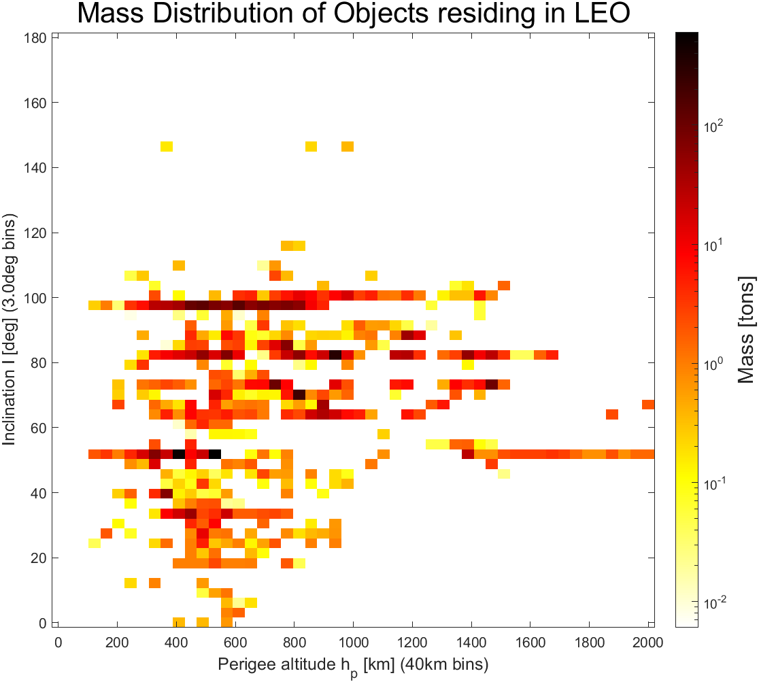
Distribution in SEP.2022

Slide 9
Orbit integration with atmospheric resistance
Space Debris

Slide 10

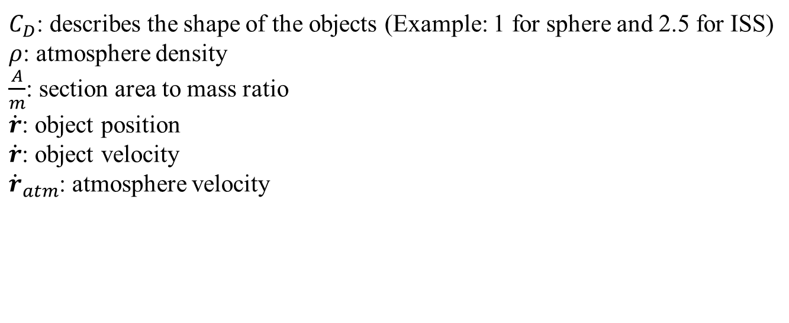
Atmospheric influence
$$\frac{f_{drag}}{m}=−\frac{1}{2}C_{D}ρ(r,t)\frac{A}{m}(\dot{r}−{\dot{r}}_{atm})\left|\dot{r}−{\dot{r}}_{atm}\right|$$
$C_{D}$: describes the shape of the objects (Example: 1 for sphere and 2.5 for ISS)
$ρ$: atmosphere density
$\frac{A}{m}$: section area to mass ratio
$\dot{r}$: object position
$\dot{r}$: object velocity
${\dot{r}}_{atm}$: atmosphere velocity

Slide 11
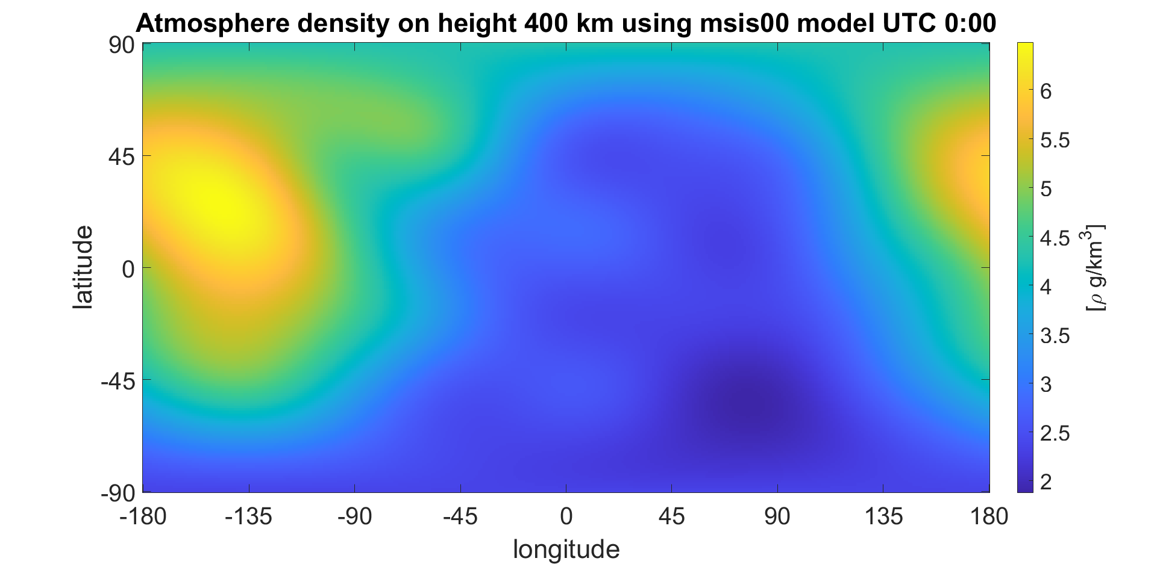
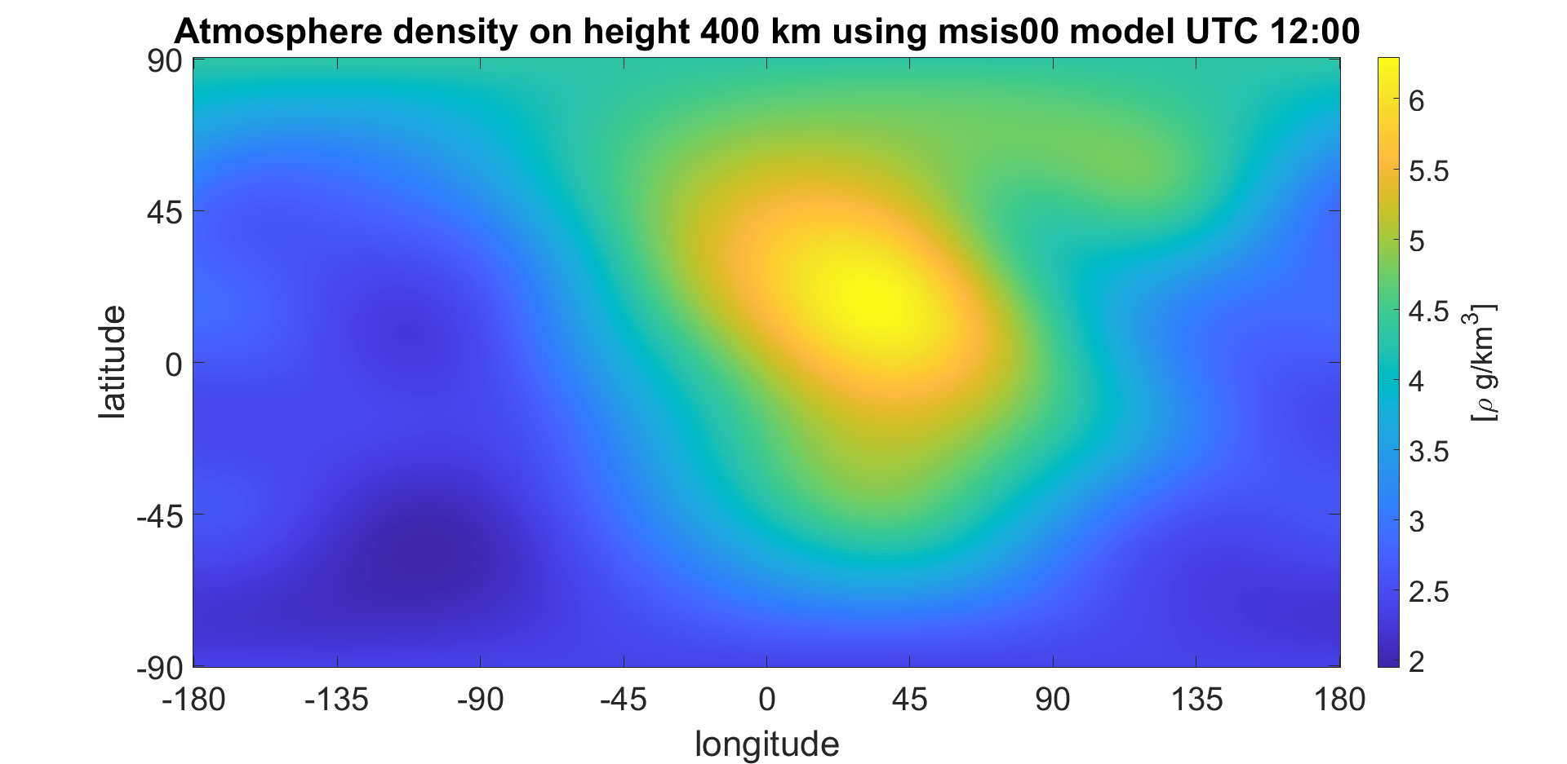
msise00 model

Slide 12
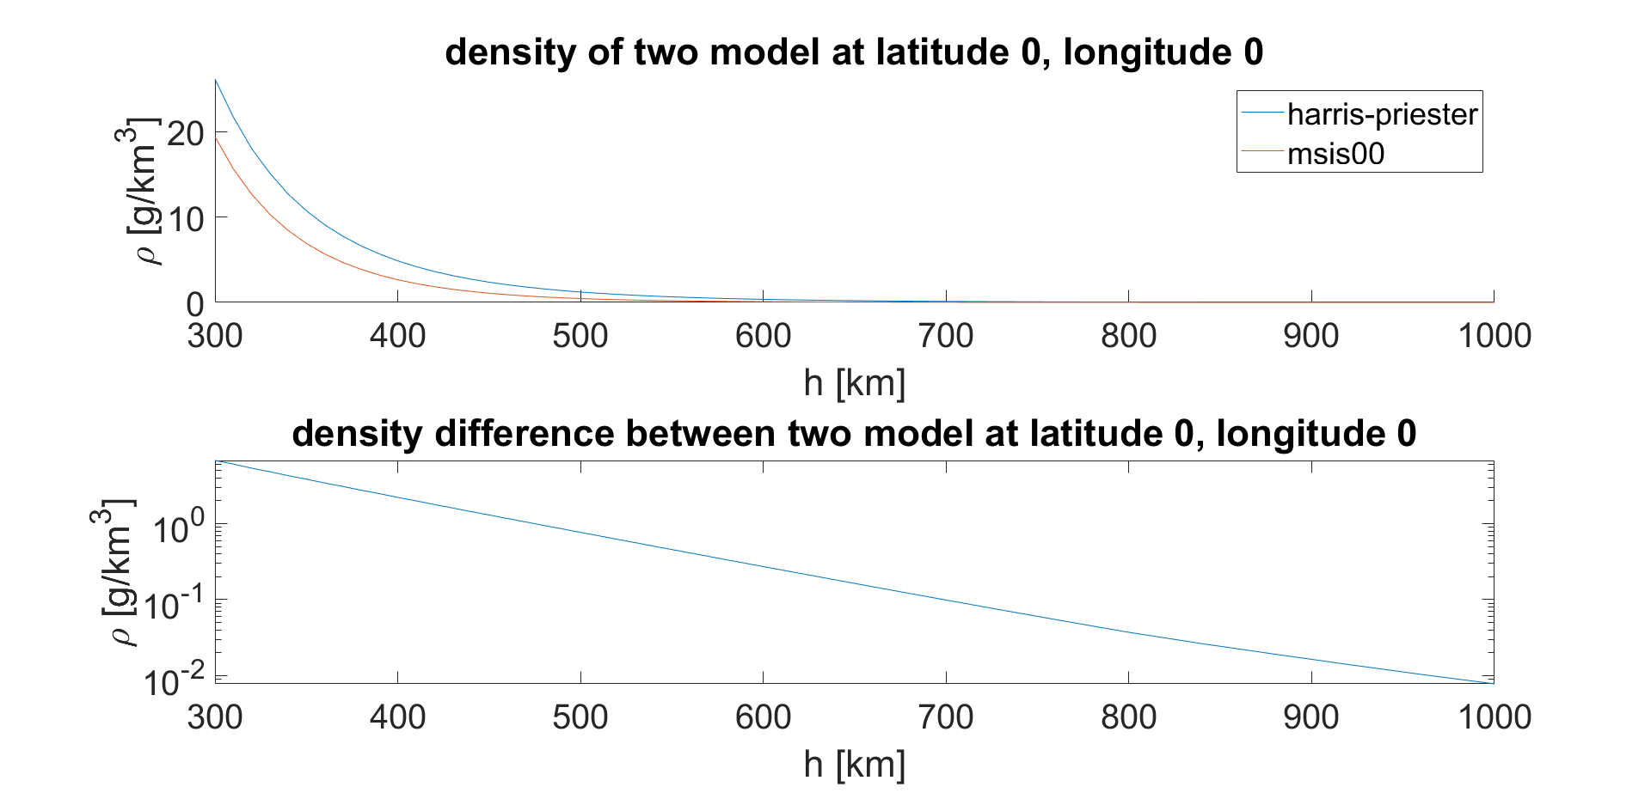
Atmosphere model compare

Slide 13
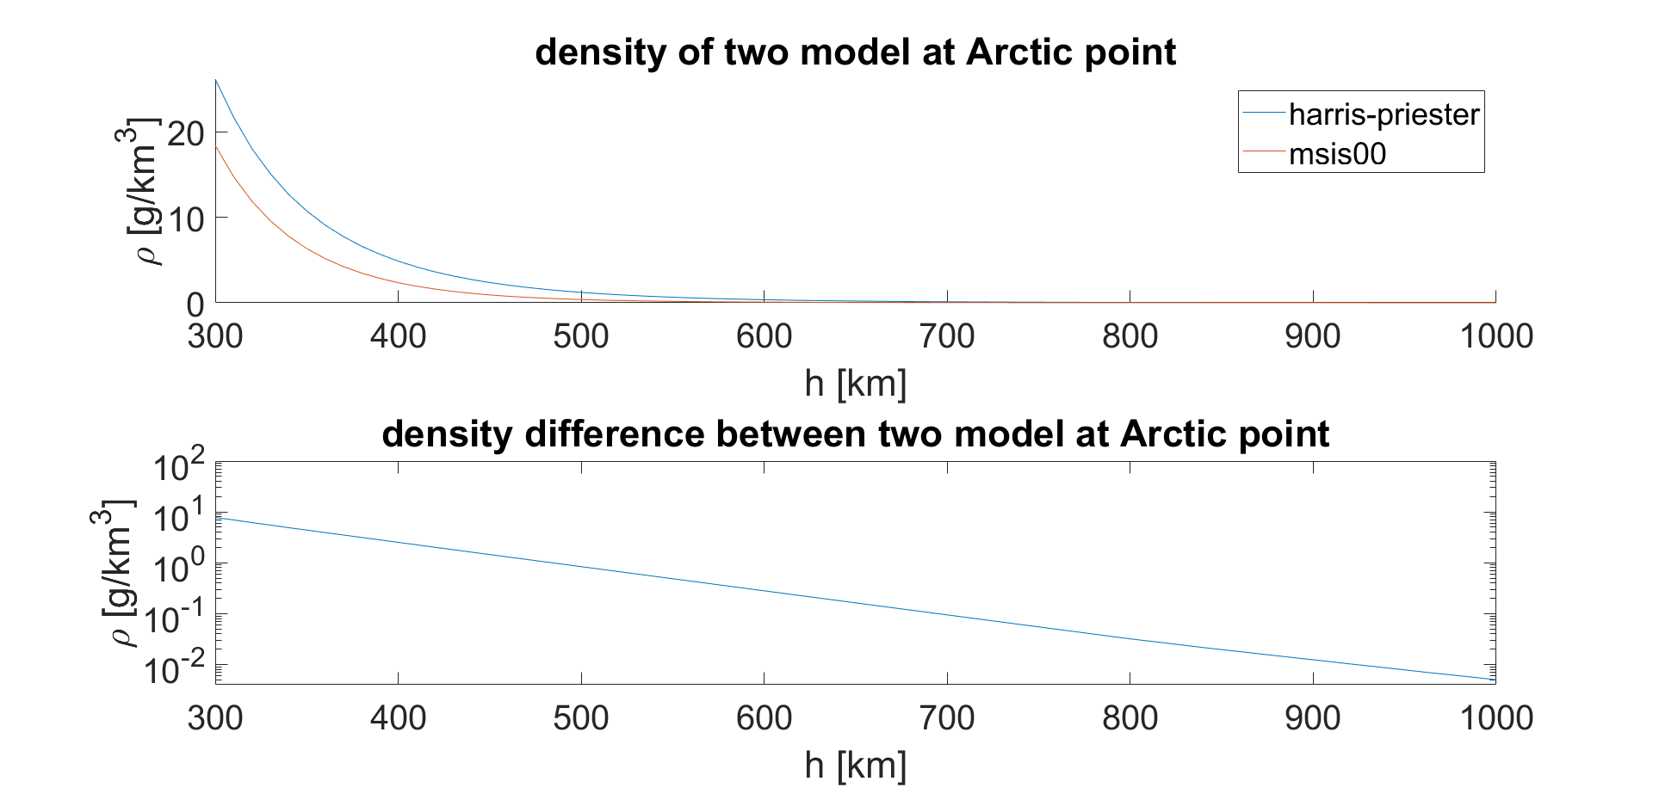
Atmosphere model compare

Slide 14
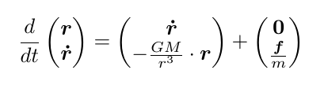
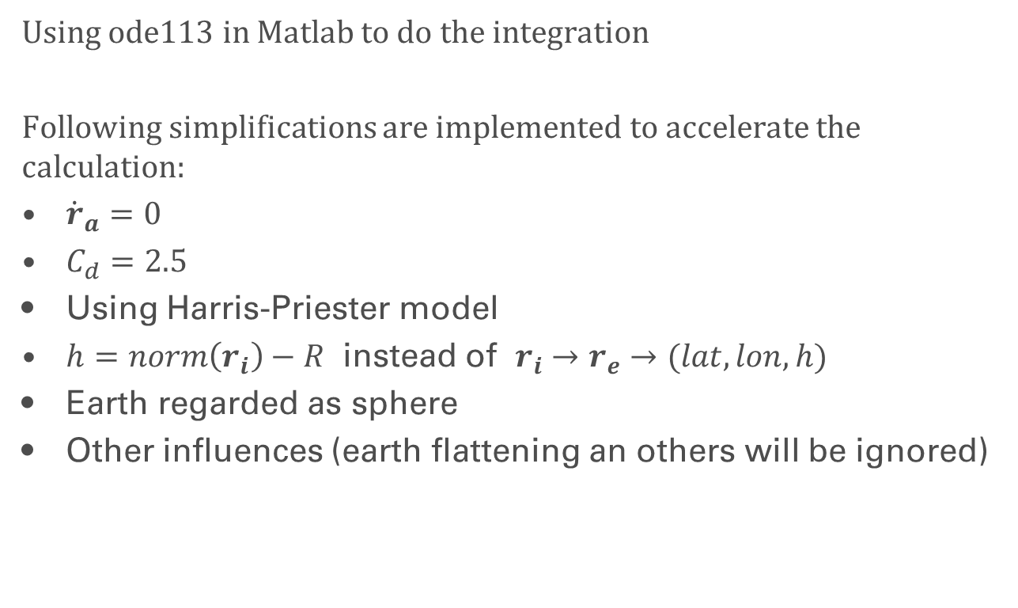
Integration and simplification
Using ode113 in Matlab to do the integration
Following simplifications are implemented to accelerate the calculation:
${\dot{r}}_{a}=0$
$C_{d}=2.5$
Using Harris-Priester model
$h=norm\left(r_{i}\right)−R$ instead of $r_{i}→r_{e}→(lat,lon,h)$
Earth regarded as sphere
Other influences (earth flattening an others will be ignored)

Slide 15
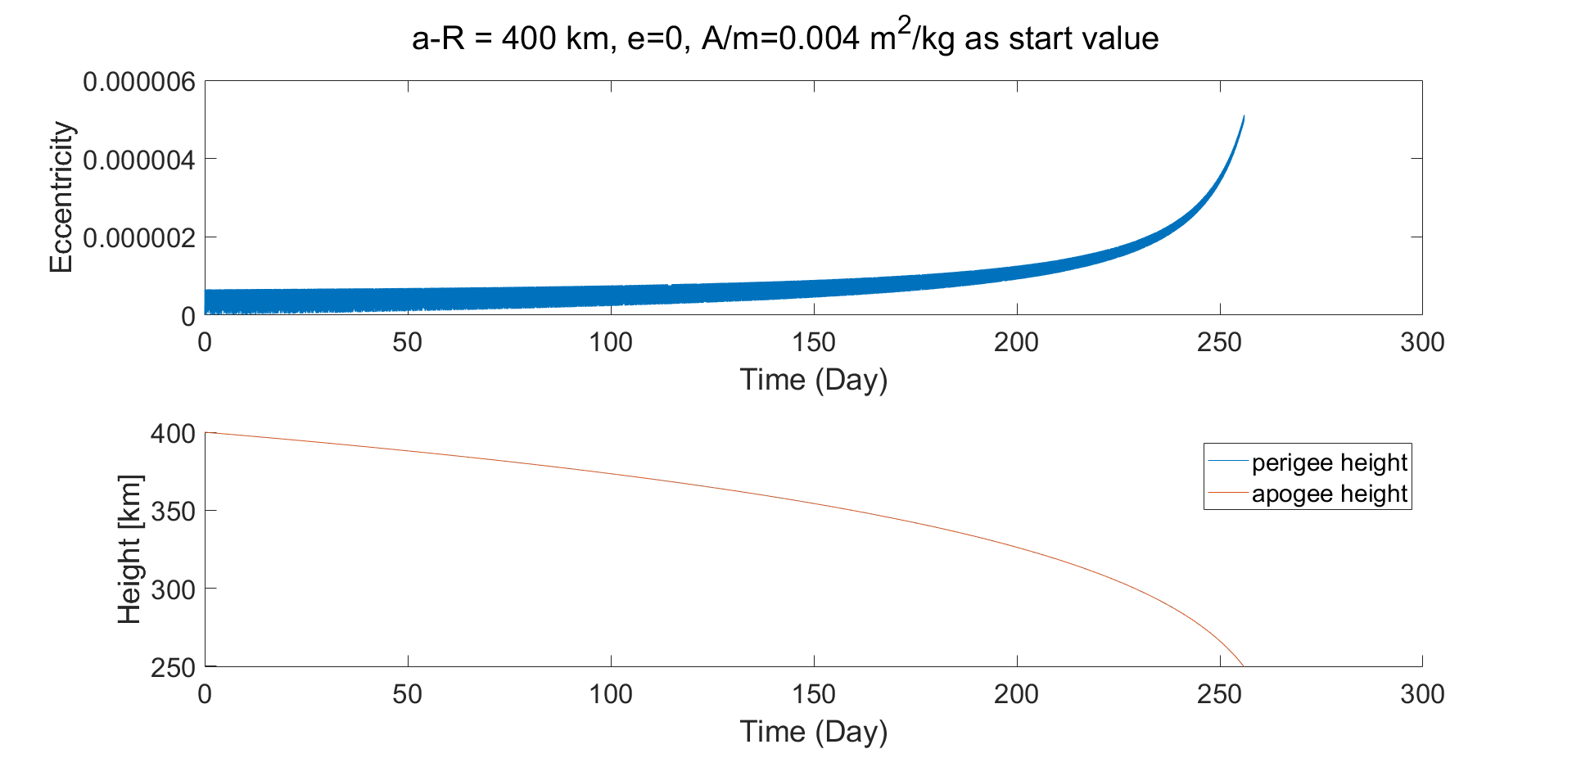
Integration Result for circular orbit

Slide 16
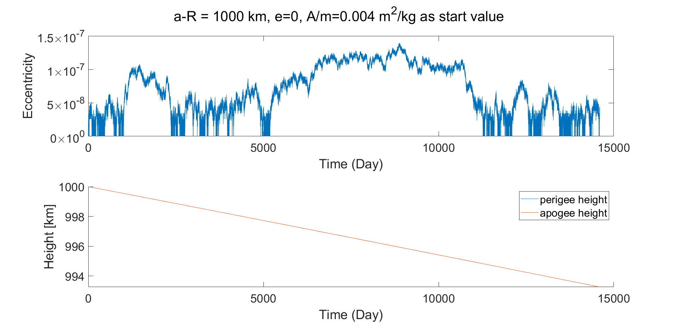
Integration Result for circular orbit

Slide 17
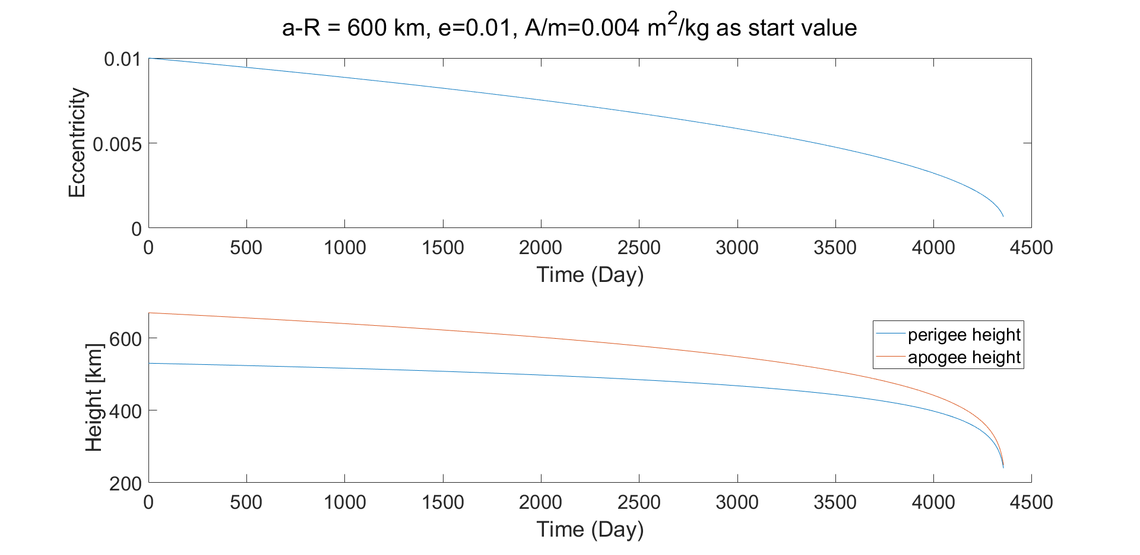
Integration Result for ellipsoidal orbit

Slide 18
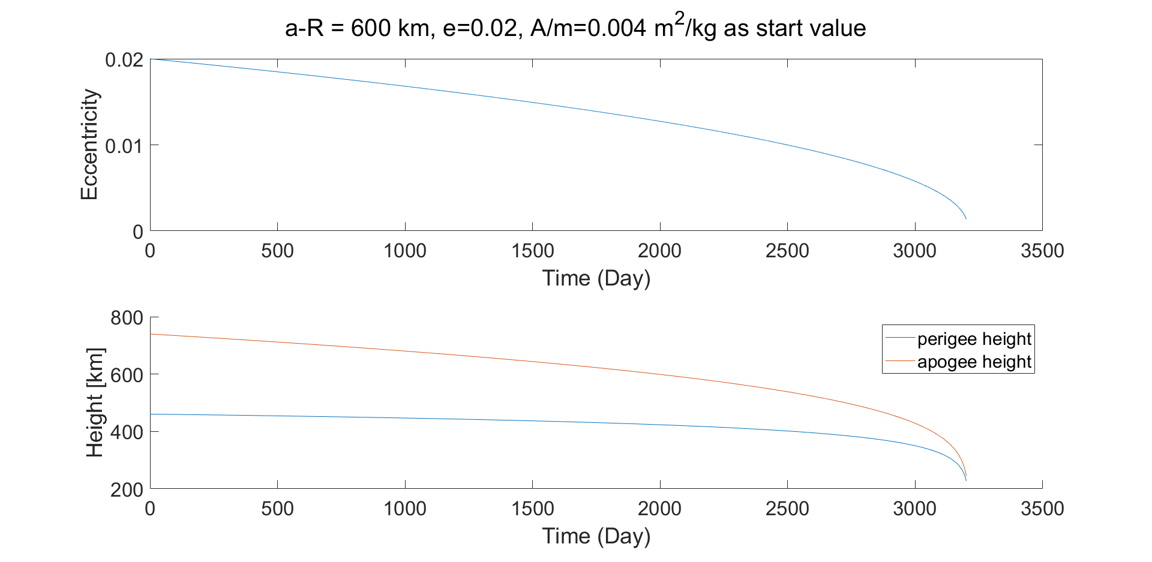
Integration Result for ellipsoidal orbit

Slide 19
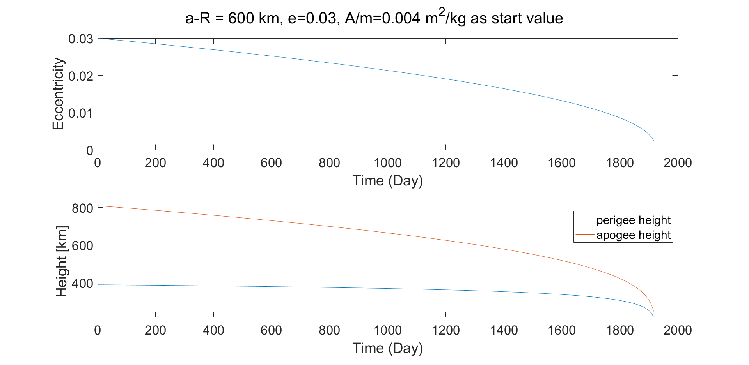
Integration Result for ellipsoidal orbit

Slide 20
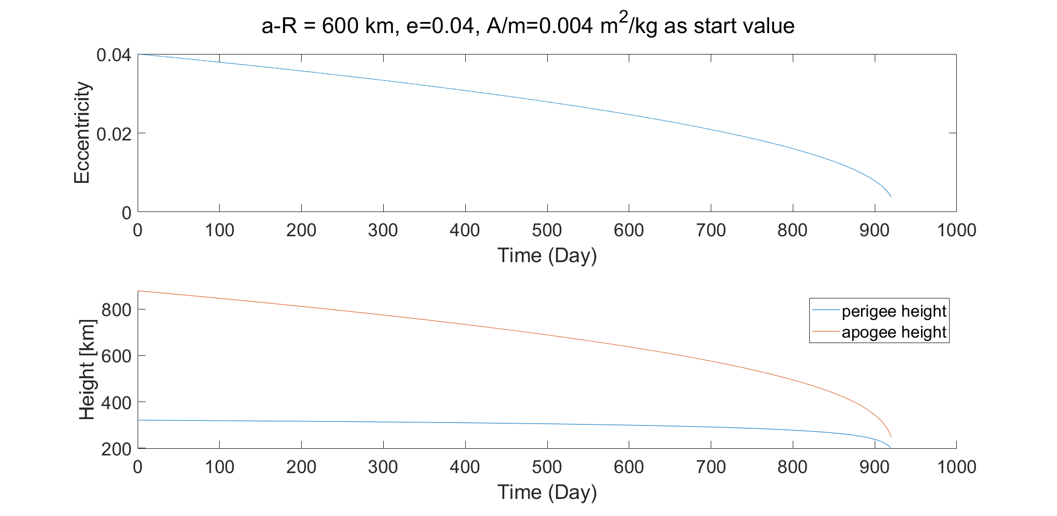
Integration Result for ellipsoidal orbit

Slide 21
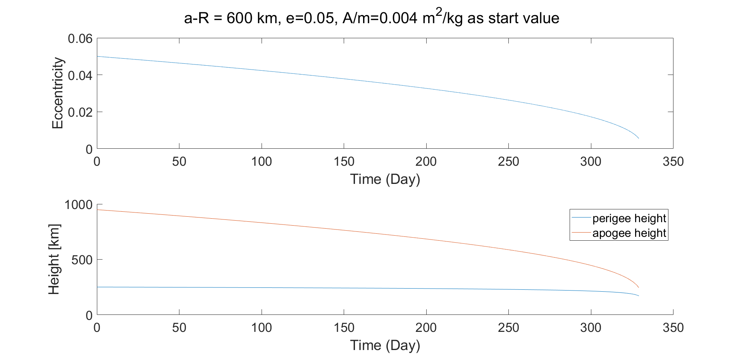
Integration Result for ellipsoidal orbit

Slide 22
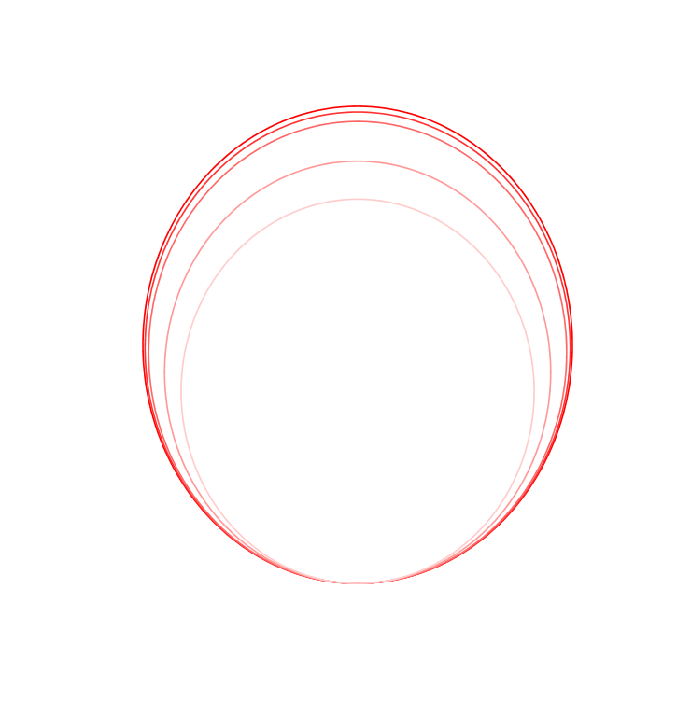
Integration Result for ellipsoidal orbit
The object with ellipsoidal orbit will decelerate when it passes perigee
apogee height decreases significantly and eccentricity gets smaller

Slide 23
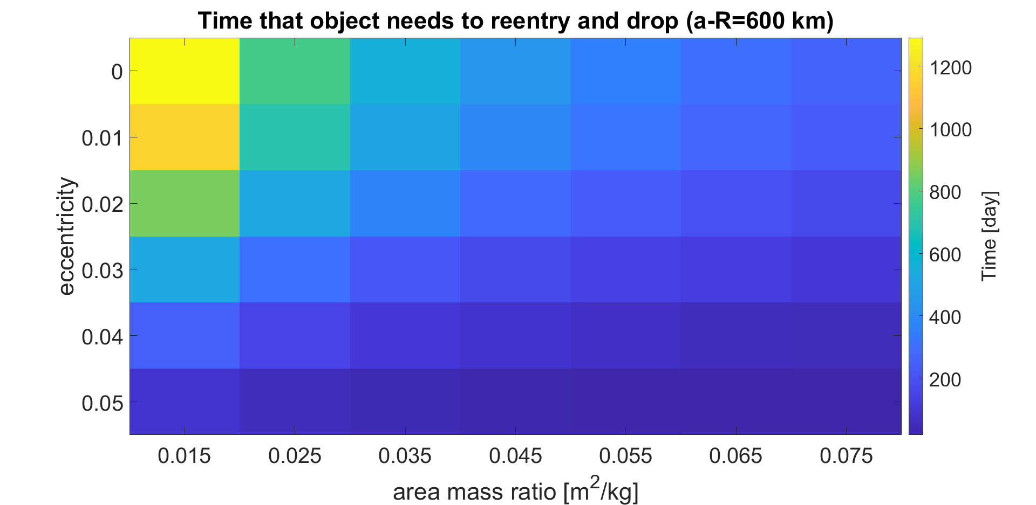
Time for reentry with different parameters

Slide 24
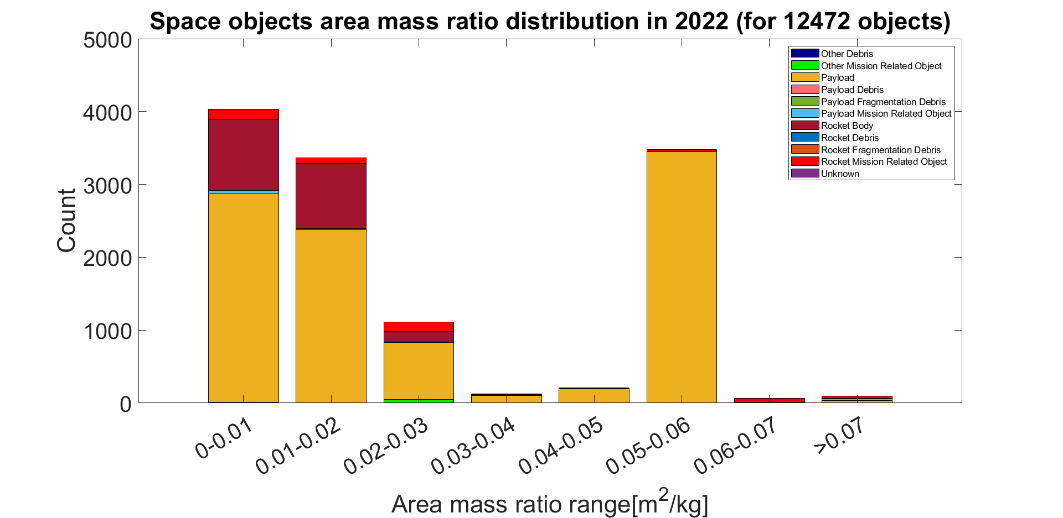
Area to mass ratio distribution
Though there are more than 20 000 objects in 2022,
only 12472 of them are know with section area and mass

Slide 25
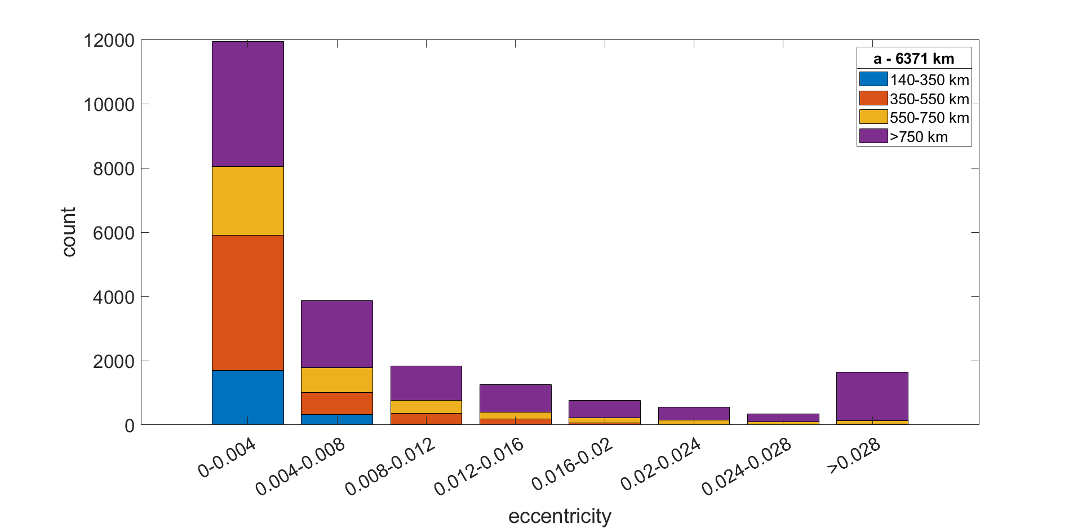
Eccentricity and long half axis distribution

Slide 26
sail based
Space Debris Removal

Slide 27
Motivation
the use of solar sails as devices to speed up the de-orbiting of LEO objects
According to rules, any European satellite within an altitude of 2000 km has to de-orbit in 25 years after the end of its mission

Slide 28

Principle
$$\frac{f_{drag}}{m}=−\frac{1}{2}C_{D}ρ(r,t)\frac{A}{m}(\dot{r}−{\dot{r}}_{atm})\left|\dot{r}−{\dot{r}}_{atm}\right|$$
the use of solar sails as devices to speed up the de-orbiting of LEO objects

Slide 29
Simulation: Equations of Motion
Orbital Dynamics
non spherical gravity field
gravitational attraction of the Moon and of the Sun, also known as third body effect
atmospheric drag
…
Attitude Dynamics and Kinematics
attitude dynamics equation
Torque, angular velocity, moment of inertia
attitude kinematics equation
Quaternion, angular velocity

Slide 30
Simulation in paper : Parameter
450 km orbit
Total Satellite Mass: 140 kg
Sail Area: 25 m^2

Slide 31
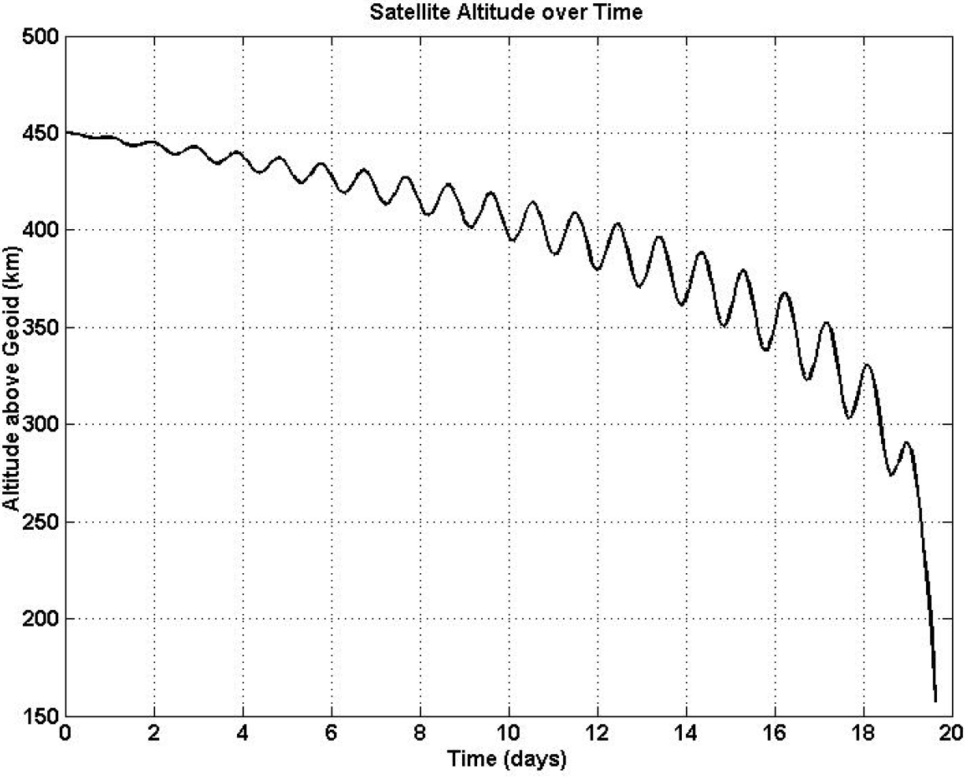
Results: altitude over the geoid over time
Source: D. Romagnoli, S. Theil [1]
considered reentered into atmosphere when Altitude = 150 km
reenters the atmosphere in approximately three weeks

Slide 32
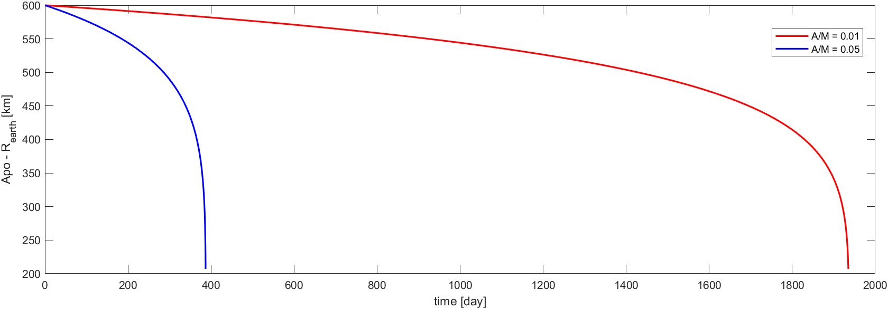
Simulation in matlab
A/M has a significant effect on the fall time

Slide 33
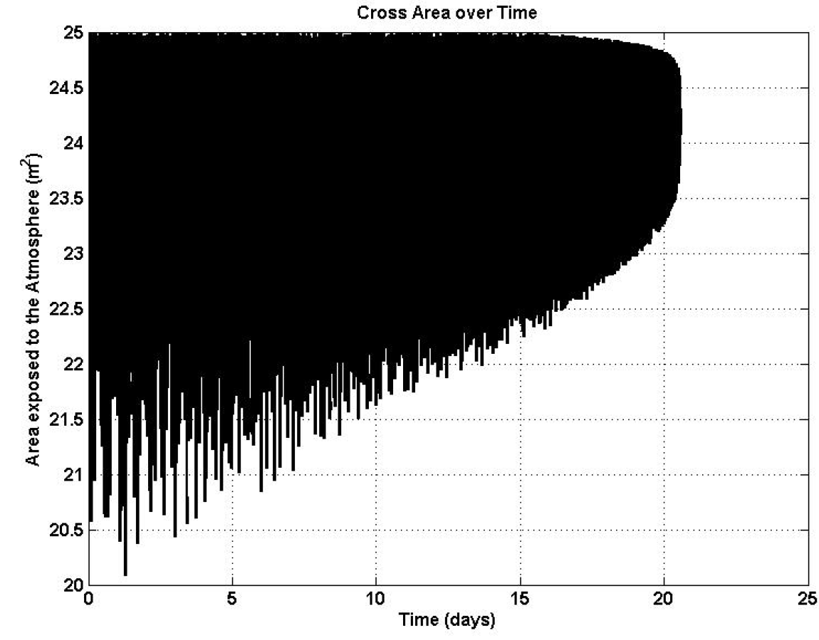
Results: cross area over time
aerodynamic torque is strong enough to provide a passive stabilization
offering a constant area of about 24 m2

Slide 34
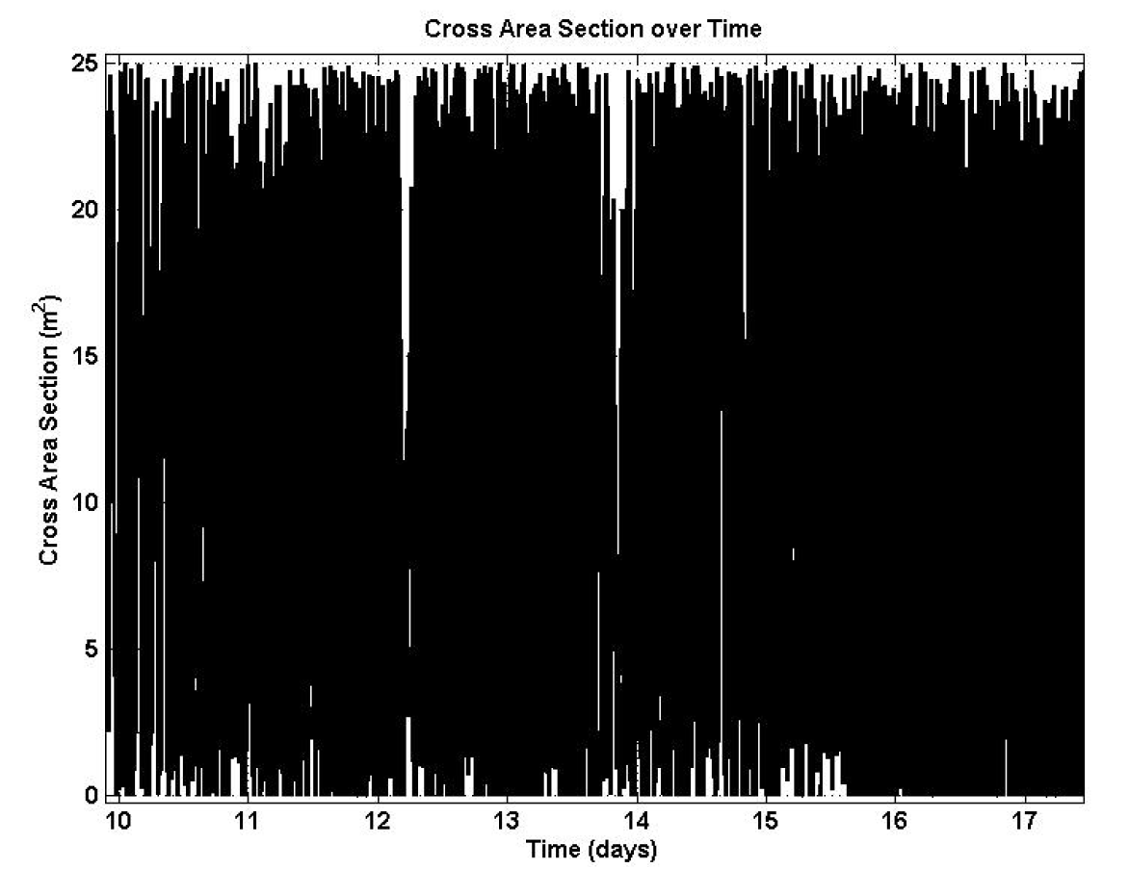
Problem: orbit at 600km
Higher altitude resulting in a much smaller drag
desired “passive stabilization” can not be achieved
the available aerodynamic torque is not enough to get rid of the satellite’s rotation

Slide 35
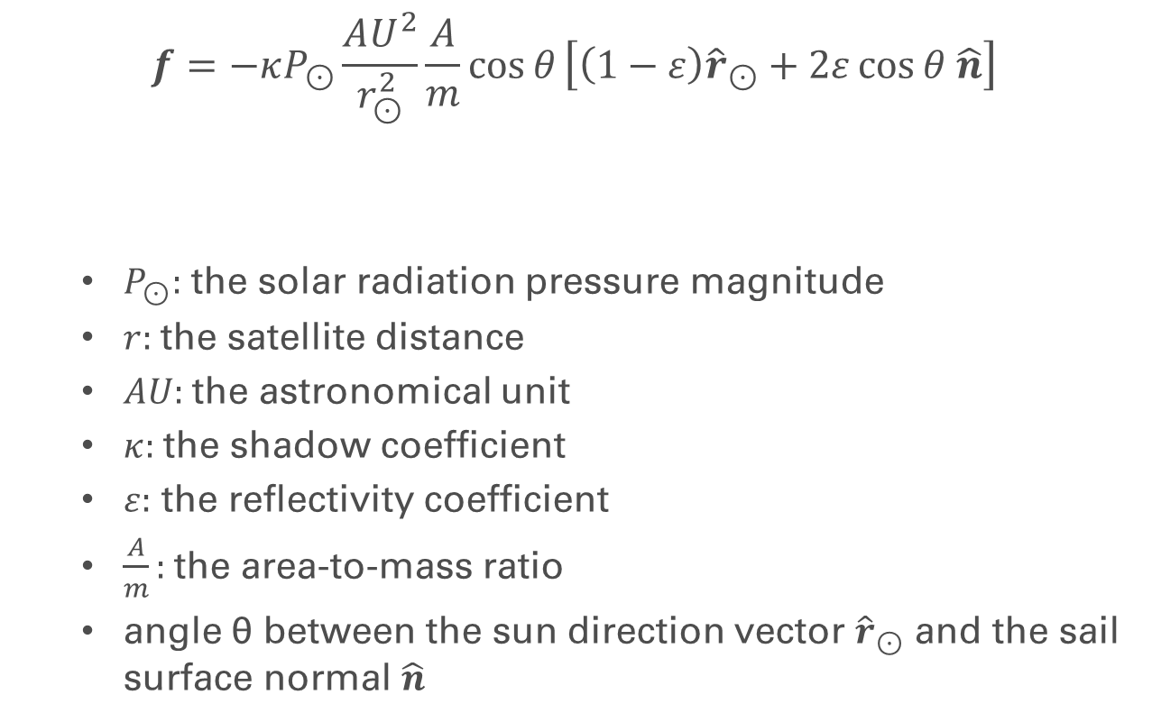
Other Approach: Solar radiation pressure
$$f=−κP_{⊙}\frac{AU^{2}}{r_{⊙}^{2}}\frac{A}{m}\cos{θ}\left[\left(1−ε\right){\hat{r}}_{⊙}+2ε\cos{θ \hat{n}}\right]$$
$P_{⊙}:$ the solar radiation pressure magnitude
$r:$the satellite distance
$AU:$the astronomical unit
$κ:$the shadow coefficient
$ε:$ the reflectivity coefficient
$\frac{A}{m}:$the area-to-mass ratio
angle θ between the sun direction vector ${\hat{r}}_{⊙}$ and the sail surface normal $\hat{n}$

Slide 36
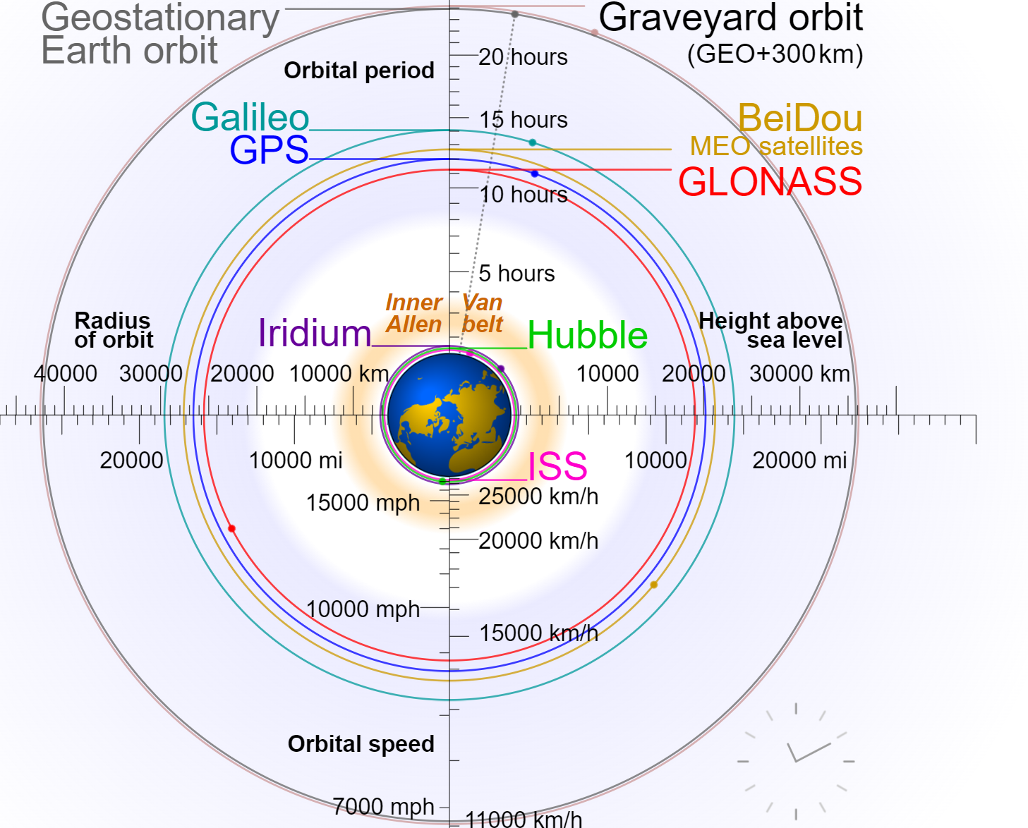
TugSat
Removing Space Debris from GEO Using Solar Sails
reorbit GEO debris to an acceptable graveyard orbit
Source: P.W. Kelly, R. Bevilacqua, L. Mazal, R.S. Erwin [2]

Slide 37
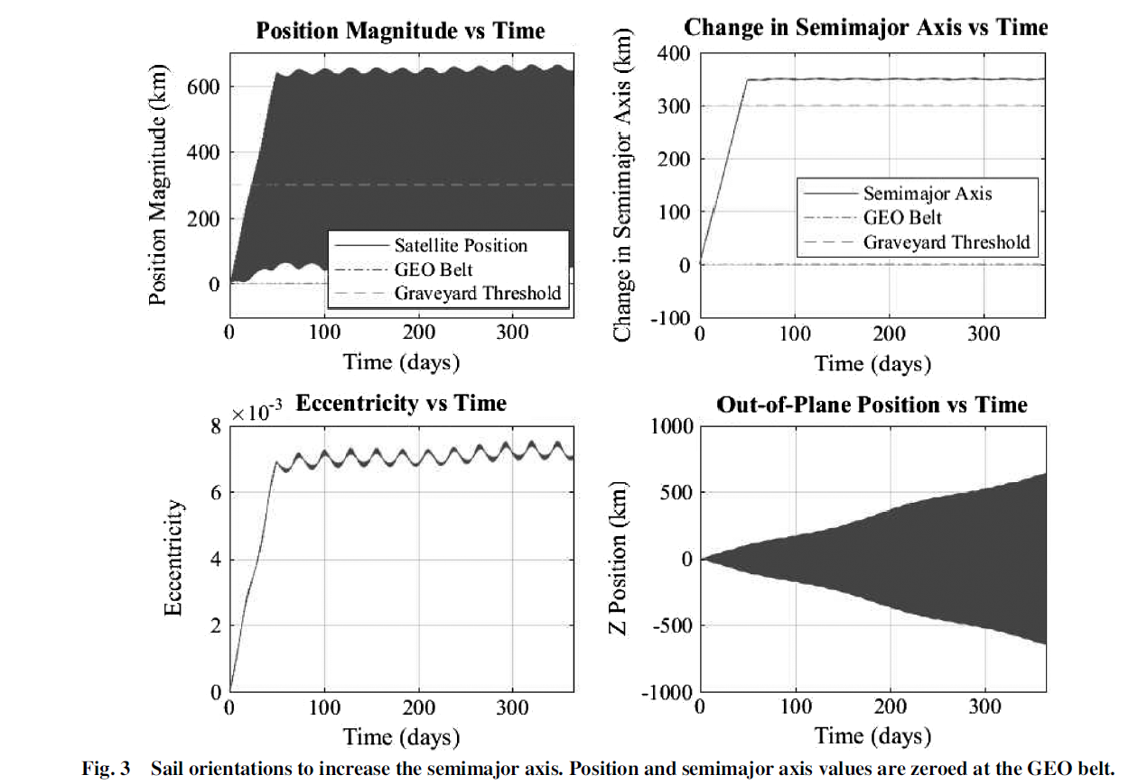
Deorbit Simulation: Semimajor Axis
TugSat will deorbit the payload by increasing the apogee and raising the semimajor axis 350 km above the altitude

Slide 38
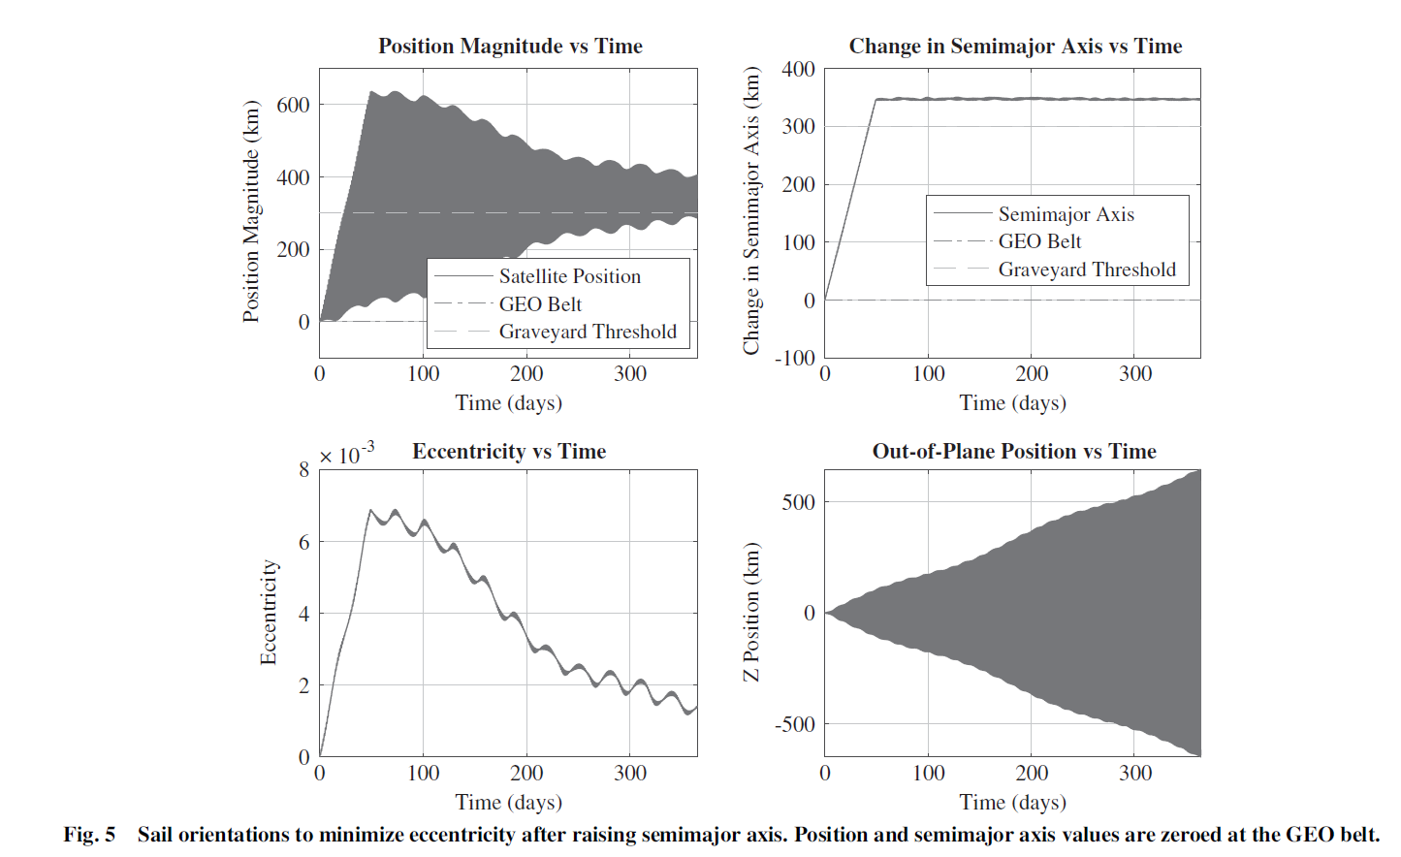
Deorbit Simulation: Eccentricity
Once the desired semimajor axis is attained, the eccentricity must be reduced so that both perigee and apogee values remain above the graveyard orbit threshold

Slide 39
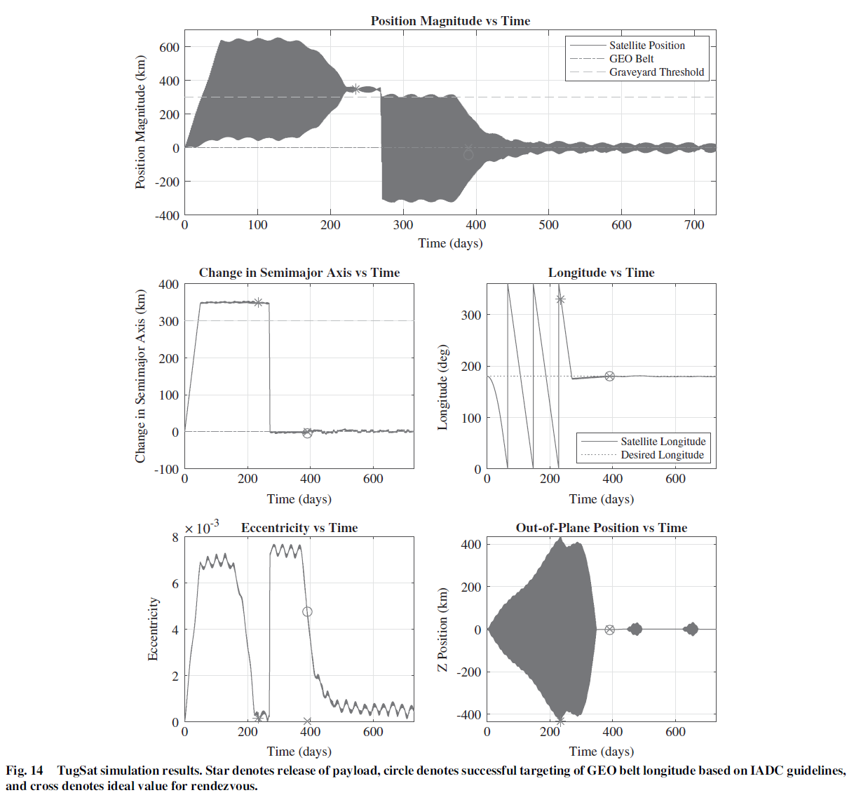
Deorbit Simulation: Return
After releasing the payload, Tugsat will return to the GEO belt, targeting its initial longitude from the start of the simulation.

Slide 40
Satellite based
Space Debris Removal

Slide 41
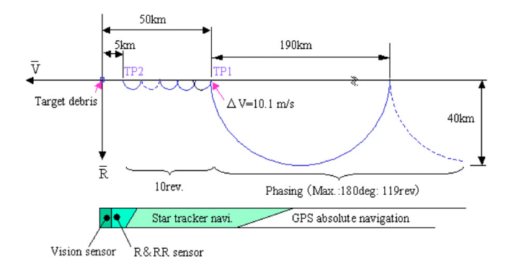
Mission concept
Typical concept to remove medium size debris in LEO, e.g. height 800 km, mass 100 kg
1. start: vehicle will be shot in the vicinity of the first target, on a slightly lower orbit, phasing
2. rendez-vous: starts about 5 km behind target, attitude and distance of the object measured with cameras
Source: Nishida, Kawamoto, Okawa, Terui, Kitamura [3]

Slide 42
Mission concept
In the vicinity of the object: estimate target movement, fly-around
Matching the rotation of the target, making contact (by robot arm, net, …)
3. de-orbiting: debris released on disposal orbit
4. moving to next target: series of orbit maneuvers, adjusting semi-major axis, inclination, RAAN to target, next rendez-vous
5. self disposal: vehicle uses last propellant for braking

Slide 43
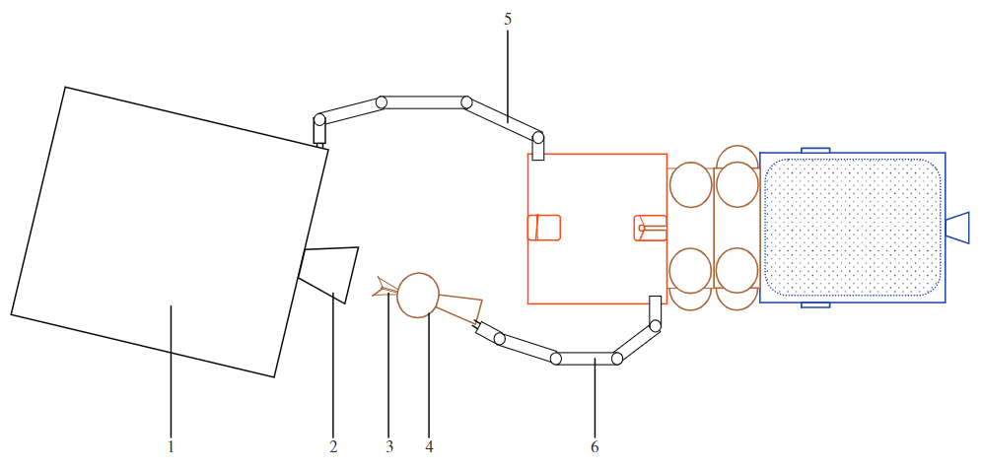
De-orbiting
Previously described system: „Phoenix“
→ Debris transported by vehicle on disposal orbit
Alternative is „Revolver“
De-orbiting device attached to debris
Debris is braking without the vehicle
→ saves fuel, and therefore weight
Source: Nishida, Kawamoto [4]

Slide 44
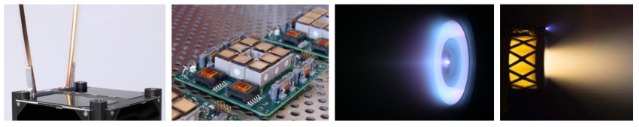
Propulsion
Chemical propulsion: A lot of mass (fuel and tank) has to be carried, only a few tagets per mission possible
Electrical propulsion: a propellant is ionised and accelerated by an electrical field or thermally
Electrodynamic tether (EDT): using the geomagnetic field and ionospheric plasma
Examples of electrical thrusters. O‘Reilly[18]

Slide 45
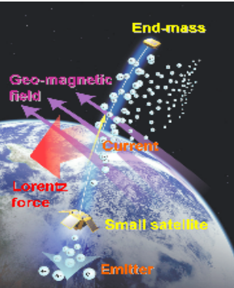
Electrodynamic tether
Long, conductive wire (up to 10-20 km)
Cathodes at both ends collect and emit electrons from ionospheric plasma
Current through wire, geomagnetic field → Lorentz force
Force used to accelerate and decelerate vehicle
Principle EDT Kobayashi [9]

Slide 46
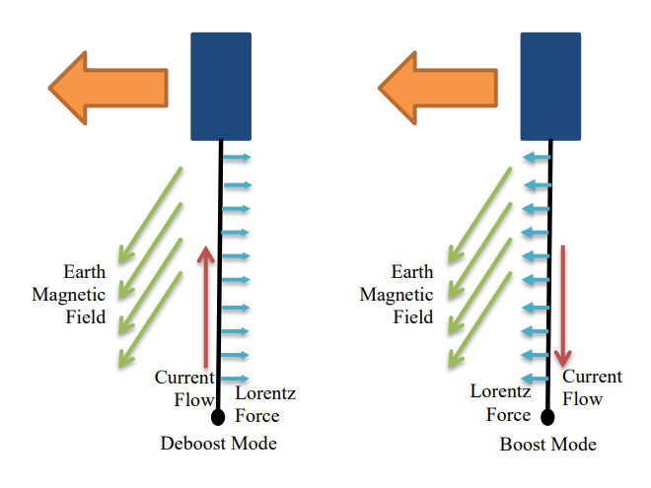
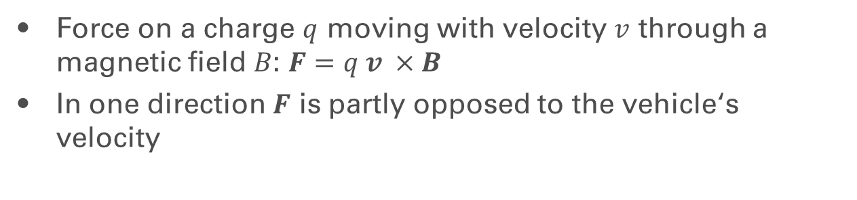
Electrodynamic tether
Boosting und deboosting modes of the EDT. Carpenter[4]
Force on a charge $q$ moving with velocity $v$ through a magnetic field $B$: $F=q v ×B$
In one direction $F$ is partly opposed to the vehicle‘s velocity

Slide 47
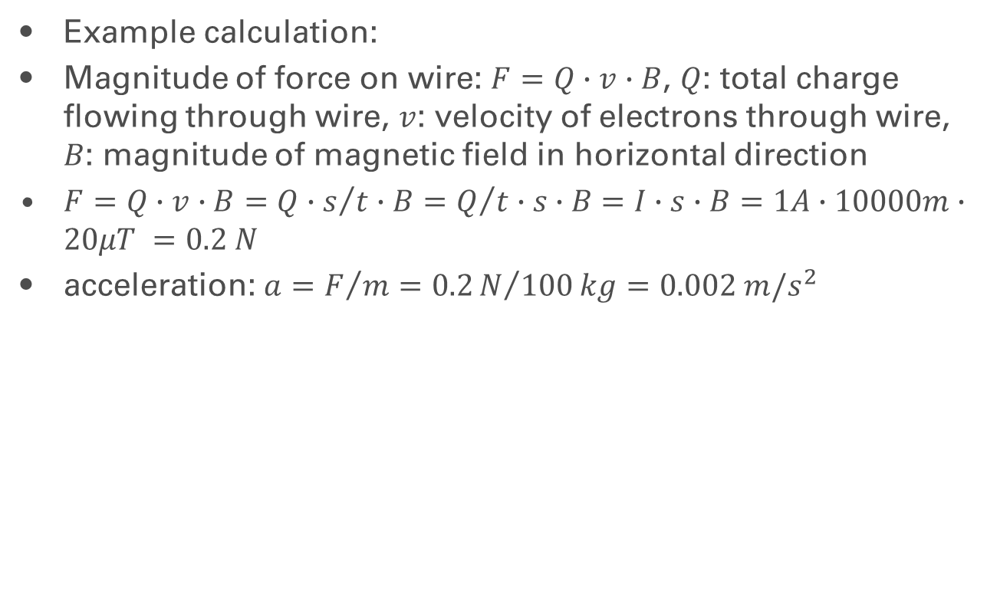
EDT - Acceleration
Example calculation:
Magnitude of force on wire: $F=Q∙v∙B$, $Q$: total charge flowing through wire, $v$: velocity of electrons through wire, $B$: magnitude of magnetic field in horizontal direction
$F=Q∙v∙B=Q∙s/t∙B=Q/t∙s∙B$ $=I∙s∙B=1A∙10000m∙20μT =0.2 N$
acceleration: $a=F/m=0.2N/{100}kg=0.002 m/s^{2}$

Slide 48
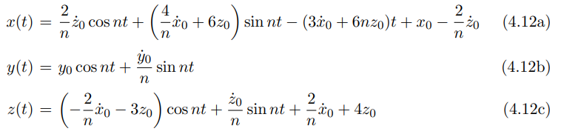
Rendez-vous – Hill equations
homogeneous solution of the Hill equations

Slide 49
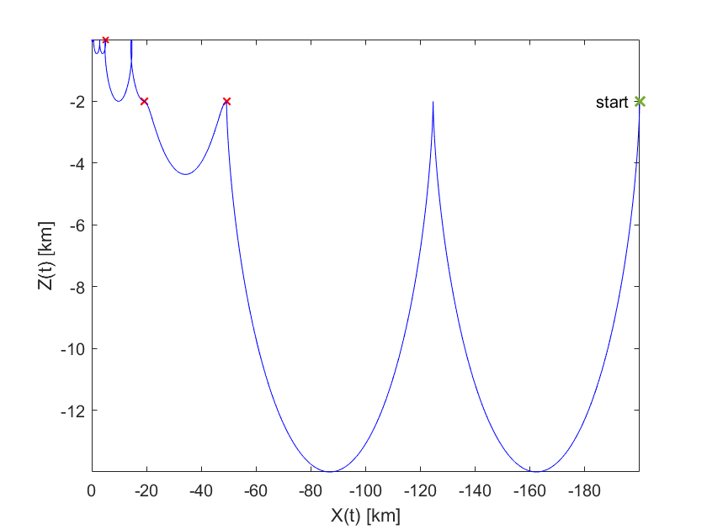
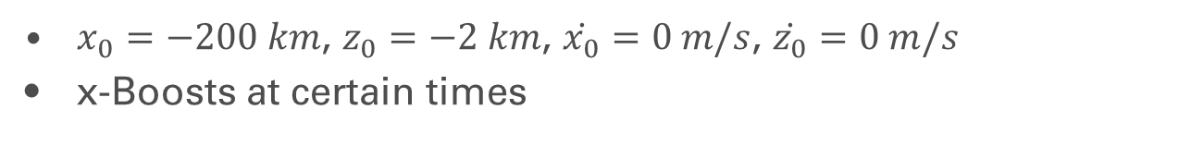
Rendez-vous
simulation of a rendez-vous - phasing
$x_{0}=−200 km$, $z_{0}=−2 km$, $\dot{x_{0}}=0 m/s$, $\dot{z_{0}}=0 m/s$
x-Boosts at certain times

Slide 50
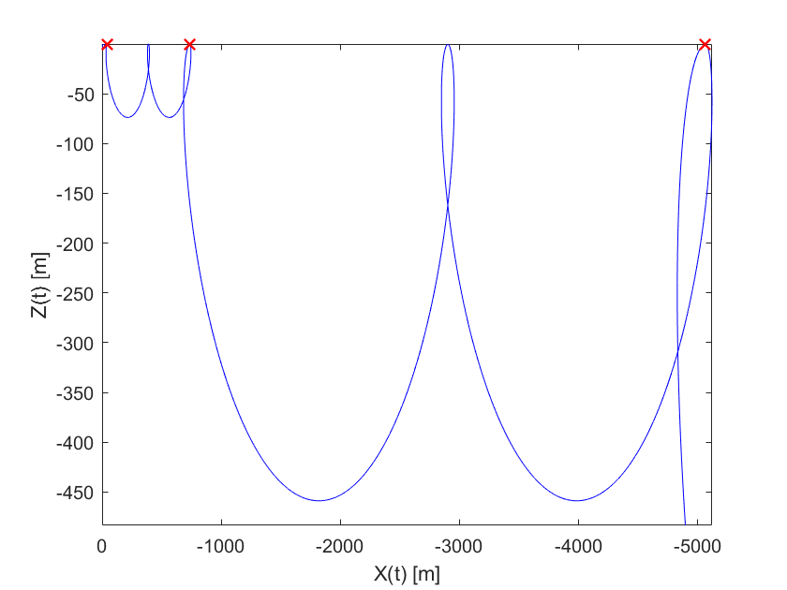
Rendez-vous
Simulation of a rendez-vous – far-range

Slide 51
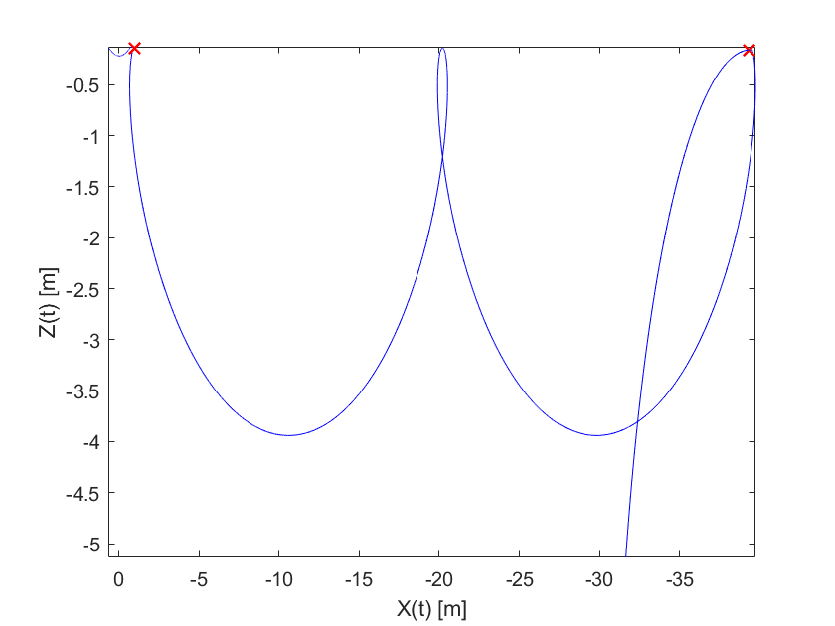
Rendez-vous
Simulation of a rendez-vous – close-range

Slide 52
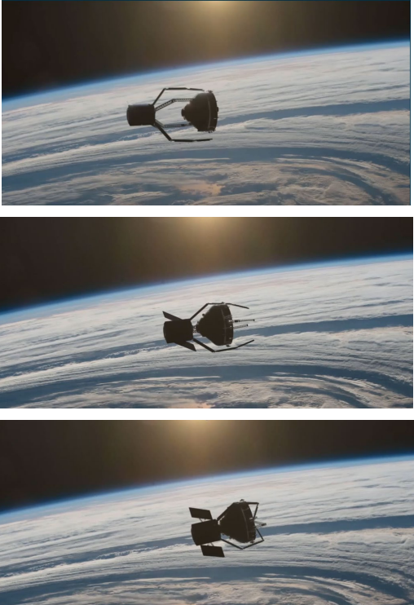
Current situation
Currently no active removal vehicle in operation
Clearspace-1 mission by ESA:
First mission to remove a debris from space
Target: rocket upper stage of 112 kg, orbit height around 800 km
Concept: grasping target with four tentacles, de-orbiting, vehicle and debris burn up together in the atmosphere
Planned launch in 2026
Project cost: 120 million CHF (status of early 2021)
Artistic depiction of capture. Biesbroek[3]

Slide 53
Challenges
Problem of tumbling debris → danger of producing new cloud of debris if capture fails
Extremely high costs of missions → problem not seen as that serious yet
Issue of responsibility for removal
Legal issues with ownership of debris objects

Slide 54
Laser orbit Debris Removal (LODR)
Space Debris Removal – Laser based

Slide 55



Concept
Ground based Debris -tracking and -removal
Debris – velocity reduction $Δv$ through impulse transmission from multiple short pulses
Perigee height of 100 km has
to be reached
Sufficient $Δv$ within one
transit
Source: C.Phipps [13]

Slide 56

Concept
Impulse through laser ablation of debris surface
direction of debris travel
Source: DLR [14] (modified)

Slide 57





Speed Change
Based on the vis viva equation one can find:
$$Δv=\sqrt{sv_{1}^{2}−\frac{2GM}{h_{a}+h_{p}}}−v_{1} \text{or} \frac{Δv}{v_{1}}=\sqrt{\frac{2h_{p}}{h_{a}+h_{p}}}$$
($v_{1}$ = Initial circular Debris orbit speed, $h_{p}$ = Perigee height, $h_{a}$ = Apogee height)
With $\frac{Δv}{v_{1}}≈3.3\%$, the required speed change results to $Δv≈242.43\frac{m}{s}$
1
1
100 km
Source: R.Soulard [15] (modified)
Notes:
Hier sagen das die benötigte Perigäumshöhe 100 km beträgt
Verlangsamung erklären, darauf eingehen das man MEHRERE Schüsse braucht als Überleitung auf die nächste Folie

Slide 58



Angular Velocity and Accuracy
With a speed of $≈7346.436 \frac{m}{s}$ at a height of 1000 km:
Given 10 cm Debris Size and 30 cm Laser-diameter:
Angular velocity of Telescope $≈7.35 \frac{mrad}{s}$
Accuracy of $± 7.1∙{10}^{−8} rad$ needed
Notes:
Für mehrere Schüsse muss das Teleskop mitschwenken. Dafür … Winkelgeschwindigkeit

Slide 59
Pros and Cons
Cheaper then satellite based methods
Multiple objects targetable during one transit
Atmospheric effects
Partly compensated using Adaptive Optics
Target localisation, Tracking and look-ahead
Pusher Laser consuming lots of energy
Bad accuracy
Notes:
Effekte: z.B. Szintillation

Slide 60
ICAN based orbital solar-powered debris sweeper
Space Debris Removal – Laser based

Slide 61

Concept
Satellite based Debris -tracking and -removal
ICAN: „International Coherent Amplification Network“
Glass fiber based Laser
System is reversible
Source: R.Soulard [15]
Notes:
Satelite based funktioniert wie Bodenbasiert, nur vom All aus (auch wieder über Ablation)
Satellite based bedingt spezielle Anforderungen an System (kompakt, robust) und Laser (hohe Energieeffizienz, gut Wärmeableitung)
Glasfaserlaser erlaubt obiges System und kann an Ziel angepasst werden
Umkehrbar: erlaubt Tracking, Lokalisierung, Oberflächenanalyse

Slide 62

Concept
3 operation modes:
Scanning Mode
Scanning and Detection
Source: R.Soulard [15]
Notes:
Scanning Mode: Streuung des Lasers, Detektion über CCD Kamera
Entfernung abhängig von Spiegelrotationsgeschwingikeit und Glasfaserzahl

Slide 63
Concept
3 operation modes:
Scanning Mode
Scanning and Detection
Tracking Mode
Object analysis
Source: R.Soulard [15]
Notes:
2. Tracking Mode. Oberflächenanalyse, anpassung des Lasers ans Objekt, Orbitbestimmung
Entfernung abhängig von Glasfaserzahl und Debriseigenschaften (Glasfaserzahl: zwischen 10km und 180 km realistisch)

Slide 64
Concept
3 operation modes:
Scanning Mode
Scanning and Detection
Tracking Mode
Object analysis
Shooting Mode
Similar to LODR
Source: R.Soulard [15]
Notes:
Auch hier wieder mehrere Schüsse, verlangsamung durch Laser Ablation
Benötigte Gesammtenergie abhängig von Objektgröße und Orbithöhe (10^1 – 10^3 KJ)
Reichweite: Abhängig von Teleskop Brennweite

Slide 65
Pros and Cons
Combined Detection, Tracking and Shooting
Mainly solar powered
No atmospheric influences
Limited lifespan
Very expensive
Notes:
Quasi keine Flüssigkeiten benötigt, keine Kühlflüssigkeiten, wenig Treibstoff
Begrenzte Lebenserwartung durch maschinelle Teile

Slide 66
Current Situation
Space Debris Removal – Laser based

Slide 67
Current Situation
Implementation is possible and needed, but…
… when does a Laser count as weapon?
And who is deciding it?
Notes:
Technologisch sind wir in der Lage die Systeme zu implementieren
Internationale Kooperation umumgänglich!!

Slide 68
Sources
[1] D. Romagnoli, S. Theil, De-orbiting satellites in LEO using solar sails, in: Proc. International Symposium on Space Flight Dynamics, 2011, pp. 1-13.
[2] P.W. Kelly, R. Bevilacqua, L. Mazal, R.S. Erwin, TugSat: removing space debris from geostationary orbits using solar sails, J. Spacecraft Rockets 55 (2) (2018)437-450, https://doi.org/10.2514/1.A33872
[3] Biesbroek, Aziz, Wolahan, Cipolla, Richard-Noca, Piguet. The Clearspace-1 mission: ESA and Clearspace team up to remove debris. Proc. 8th European Conference on Space Debris (2021).
[4] Carpenter. Use of Electrodynamic Tethers for Satellite End of Life Deorbit Maneuvers.
[5] Castronuovo. Active space debris removalda preliminary mission analysis and design, Acta Astronaut. 69 (2011), 848-859.
[6] Covello. Application of electrical propulsion for an active debris removal system: a system engineering approach, Adv. Space Res. 50 (2012), 918-931.
[7] Gilchrist, Bilén, Hoyt, Stone, Vaughn, Fuhrhop, Khazanov, Krause, Johnson. The PROPEL Electrodynamic Tether Mission and Connecting to the Ionosphere. 12th Spacecraft Charging Technology Conference (2012).

Slide 69
Sources
[8] Levin, Pearson, Carroll. Wholesale debris removal from LEO, Acta Astronaut. 73 (2012), 100-108.
[9] Kobayashi, Yamagiwa, Otsu, Kawamoto (2009). Deployment Dynamics Of An Electrodynamic Tether From A Small Satellite. Transactions of The Japan Society for Aeronautical and Space Sciences, Space Technology Japan. 7.
[10] Nishida, Kawamoto. Strategy for capturing of a tumbling space debris, Acta Astronaut. 68 (2011), 113-120.
[11] Nishida, Kawamoto, Okawa, Terui, Kitamura. Space debris removal system using a small satellite, Acta Astronaut. 65 (2009) 95-102
[12] Ruggiero, Pergola, Andrenucci. Small electric propulsion platform for active space debris removal, IEEE Trans. Plasma Sci. 43 (No. 12) (2015) 4200-4209
[13] C. Phipps, Clearing space debris with lasers, SPIE, 2012.
[14] H. A. Eckel et. Al., Laser-Based Space Debris Removal, JAPCC Journal 22, 2016
[15] R. Soulard, et al., ICAN: A novel laser architecture for space debris removal, 2014, in: Acta Astronautica, Volume 105, Issue 1, 2014, Pages 192-200, ISSN 0094-5765, https://doi.org/10.1016/j.actaastro.2014.09.004.

Slide 70
Sources
[16] P. Maier, et al., ISU team project: an integral view on space debris mitigation and removal, 2013, in: Proceedings of 6th European Conference on Space Debris, Darmstadt 22–25
[17] C. Phipps et al., ORION: Clearing near-Earth space debris using a 20-kW, 530-nm, Earth-based, repetitively pulsed laser, Laser and Particle Beams, 14. 1 – 44, 1996
[18] O’Reilly, Herdrich, Kavanagh. Electric Propulsion Methods for Small Satellites: A Review. Aerospace 2021, 8, 22

Slide 71
Thank you very much

